Slide 1
NO LIMITS
To God’s Justice

Slide 2
Hopes dashed

Slide 3
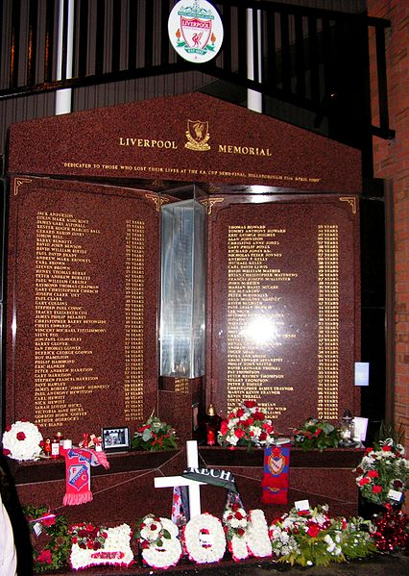
JUSTICE FOR PAST EVENTS

Slide 4
WHERE IS THE GOD OF JUSTICE?

Slide 5
Two Realities
GOD IS JUST, RIGHTEOUS AND GOOD
THE WORLD IS FULL OF EVIL AND SUFFERING

Slide 6
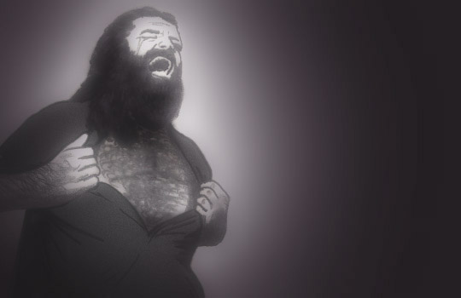
Where is Your justice?

Slide 7
God is just:
He is the Rock, his works are perfect and all his ways are just…
Righteousness and justice are the foundation of your throne…
For the LORD is a God of justice…
God is just…

Slide 8
The world is evil:
God created the world good
Evil came in and corrupted humanity
Evil must be judged by a holy and just God

Slide 9
God’s Promise to Abraham

Slide 10
God commissions Israel

Slide 11
The Old Testament Story
Judgement tempered with mercy
Punishment balanced with promise
Always pointing forward to the goal of redemption

Slide 12
God watches over the nations

Slide 13
God’s judgements:
Final
Universal
true

Slide 14
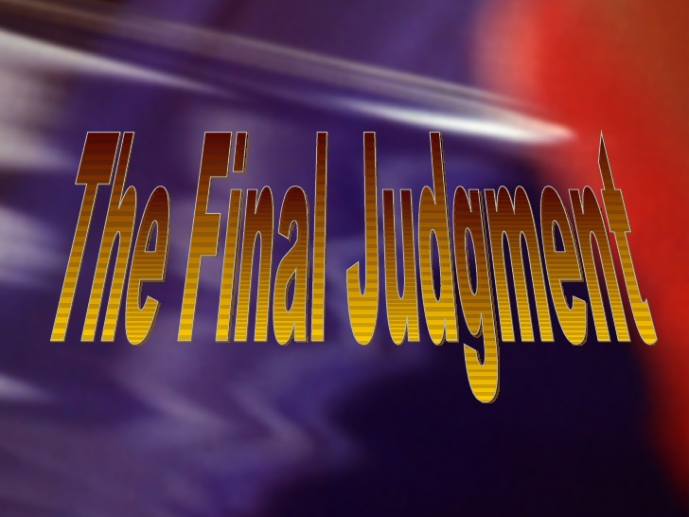
Jesus will be the Judge

Slide 15
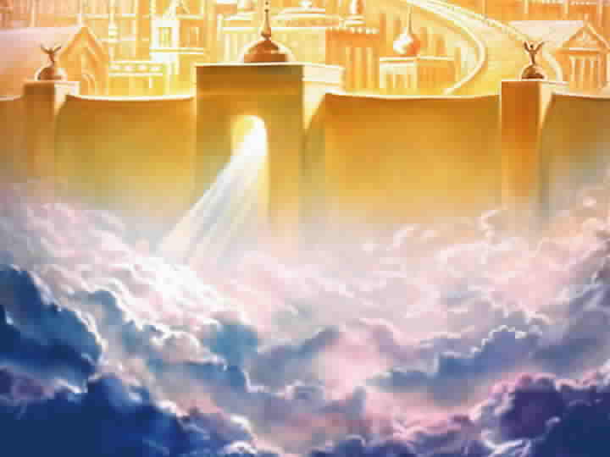
The City of God

Slide 16
The Offer of Forgiveness

